Slide 1


Slide 3

Digital Skilling & Prototyping Challenge Bootcamp
Designed to acquaint participants with foundational skills in a variety of digital tools and technologies to spur creative thinking and innovative application of digital technologies in every-day life.
From 14th April to 30th April 2021
Hands-on, Self-learning and Self-paced
Exclusive access to multimedia eLearning resources
Learn from home using computer & Internet
Acquire up to 30+ digital skills
Build a prototype to address a practical need using skills acquired
Win exciting prizes!

Slide 4
Participation Highlights
552
3
6
3
Registered
States
Districts
Karnataka, Uttar Pradesh, West Bengal
6
254
10
3
75
Active Participants
Participating Schools
Top Participating Schools
Students: 217
Teachers: 26
Parents: 11
Air Force School Hebbal,
Harvest International School
Sri Vidya Kendra

Slide 5
Skills and Prototypes
32
3
1,960
Skills Offered
Top Skills
Total Skills Acquired
8
75
Student: Online Quiz, Music, Photo Collage
Parent: Photo Collage, Music, Video Story
Teachers: Photo Collage, Online Quiz, QR Code
Average Skills
Prototypes Built

Slide 6
Top 25% participants with most no. of skills

Slide 7
Recognitions for participants who have acquired the most no. of skills
# | Participant Type | No. of Recognitions
1 | Students | 43
2 | Teachers | 4
3 | Parents | 2

Slide 8
Students who have acquired the most no. of skills
# | Student Name | Class | School
1 | Aditya B Naik | 8 B | Air Force School Hebbal
2 | Kashyap Subramanian | 12 A | Harvest International School
3 | Ayisha Shirine | 8 B | Harvest International School
4 | Kshitish Raj Dwivedi | 9 A | Air Force School Hebbal
5 | Malla Jaideep | 7 B | Air Force School Hebbal
6 | Eluru Jayadith | 6 A | Air Force School Hebbal
7 | Niharika Nair | 7 D | Harvest International School

Slide 9
Students who have acquired the most no. of skills
# | Student Name | Class | School
8 | Shaurya Utane | 7 C | Harvest International School
9 | Sagarika Shyam | 12 A | Air Force School Hebbal
10 | Arif Khan | 6 A | Harvest International School
11 | Aryan Rai | 8 A | Air Force School Hebbal
12 | Dhruv Shyam | 6 B | Air Force School Hebbal
13 | Havila Varshini Bachika | 6 A | Harvest International School
14 | Varsha D | 10 B | Air Force School Hebbal

Slide 10
Students who have acquired the most no. of skills
# | Student Name | Class | School
15 | Jashith Makireddi | 8 A | Harvest International School
16 | Kanak Arora | 7 | Harvest International School
17 | Sabah Sumehra | 9 D | Harvest International School
18 | Samarth | 7 D | Sri Vidya Kendra – The Smart School
19 | Shivamsh | 9 | Sri Vidya Kendra – The Smart School
20 | Aditya Mohan | 6 D | Harvest International School
21 | K Bhuvan Reddy | 10 B | Air Force School Hebbal

Slide 11
Students who have acquired the most no. of skills
# | Student Name | Class | School
22 | Shaurya Chopra | 7 A | Air Force School Hebbal
23 | Akshat Singh | 6 B | Air Force School Hebbal
24 | Anirudh G Kashyap | 10 C | Sri Vidya Kendra – The Smart School
25 | Bhavani R | 10 A | Air Force School Hebbal
26 | Doyel Bhattacharjee | 8 A | Air Force School Hebbal
27 | Risha R Roney | 6 C | Harvest International School
28 | Sivaram. P | 7 A | Air Force School Hebbal

Slide 12
Students who have acquired the most no. of skills
# | Student Name | Class | School
29 | Suhas | 6 C | Harvest International School
30 | Aahanaa K K | 7 A | Air Force School Hebbal
31 | Namratha Ganesh | 7 D | Harvest International School
32 | Neha Anna John | 10 A | Sri Vidya Kendra – The Smart School
33 | Padiri Charishma Reddy | 6 B | Air Force School Hebbal
34 | Sinchana Suha | 8 B | Sri Vidya Kendra – The Smart School
35 | Yukthi.R | 8 B | Air Force School Hebbal

Slide 13
Students who have acquired the most no. of skills
# | Student Name | Class | School
36 | Ankur Saha | 7 B | Air Force School Hebbal
37 | Ayan Banerjee | 8 A | Air Force School Hebbal
38 | Harini Srinivasan | 8 A | Air Force School Hebbal
39 | K Pujasree | 6 A | Air Force School Hebbal
40 | Rishika .K. Shyam Sunder | 6 E | Vidyaniketan Pubic School
41 | Saanvi Nazre | 6 A | Air Force School Hebbal
42 | V.B Laksha | 7 A | Air Force School Hebbal
43 | Zarah Ushas | 8 A | Harvest International School

Slide 14
Teachers who have acquired the most no. of skills
# | Teacher Name | School
1 | Anjana Dubey | Air Force School Hebbal
2 | Umme Haani | Air Force School ASTE
3 | Gracy Daisy Jose | Air Force School ASTE
4 | Deblina Bhattacharjee | Air Force School Hebbal

Slide 15
Parents who have acquired most no. of skills
# | Parent Name
1 | Jayalakshmi Shyam
2 | Srinivasan Iyer

Slide 16
Digital Prototype Evaluation Criteria
# | Criteria | Weightage
1 | How well does your prototype address a specific need, problem or challenge | 30%
2 | How novel or innovative is your solution to the identified need, problem or challenge | 10%
3 | How many skills are used to put together your prototype | 30%
4 | How well you have integrated two or more skills to enhance the 'value' of your prototype | 20%
5 | How well you have packaged and presented (appearance) your prototype | 10%

Slide 17
Prototyping Challenge Awards
Time to reveal
Revealing

Slide 18
RUNNERS-UP
STUDENTS

Slide 19

Havila Varshini Bachika
6A, Harvest International School, Bangalore
RUNNER-UP
Rs. 200 Gift Voucher
PROTOTYPE NAME:
7 Wonders of the World
SUMMARY:
Enables anyone to take a virtual tour of the 7 wonders of the world without having to risk travelling during this pandemic.

Slide 21

Niharika Nair
7 D, Harvest International School
RUNNER-UP
Rs. 200 Gift Voucher
PROTOTYPE NAME:
Know your Spellings
SUMMARY:
Helps students learn the correct spellings of words with fun activities.

Slide 23
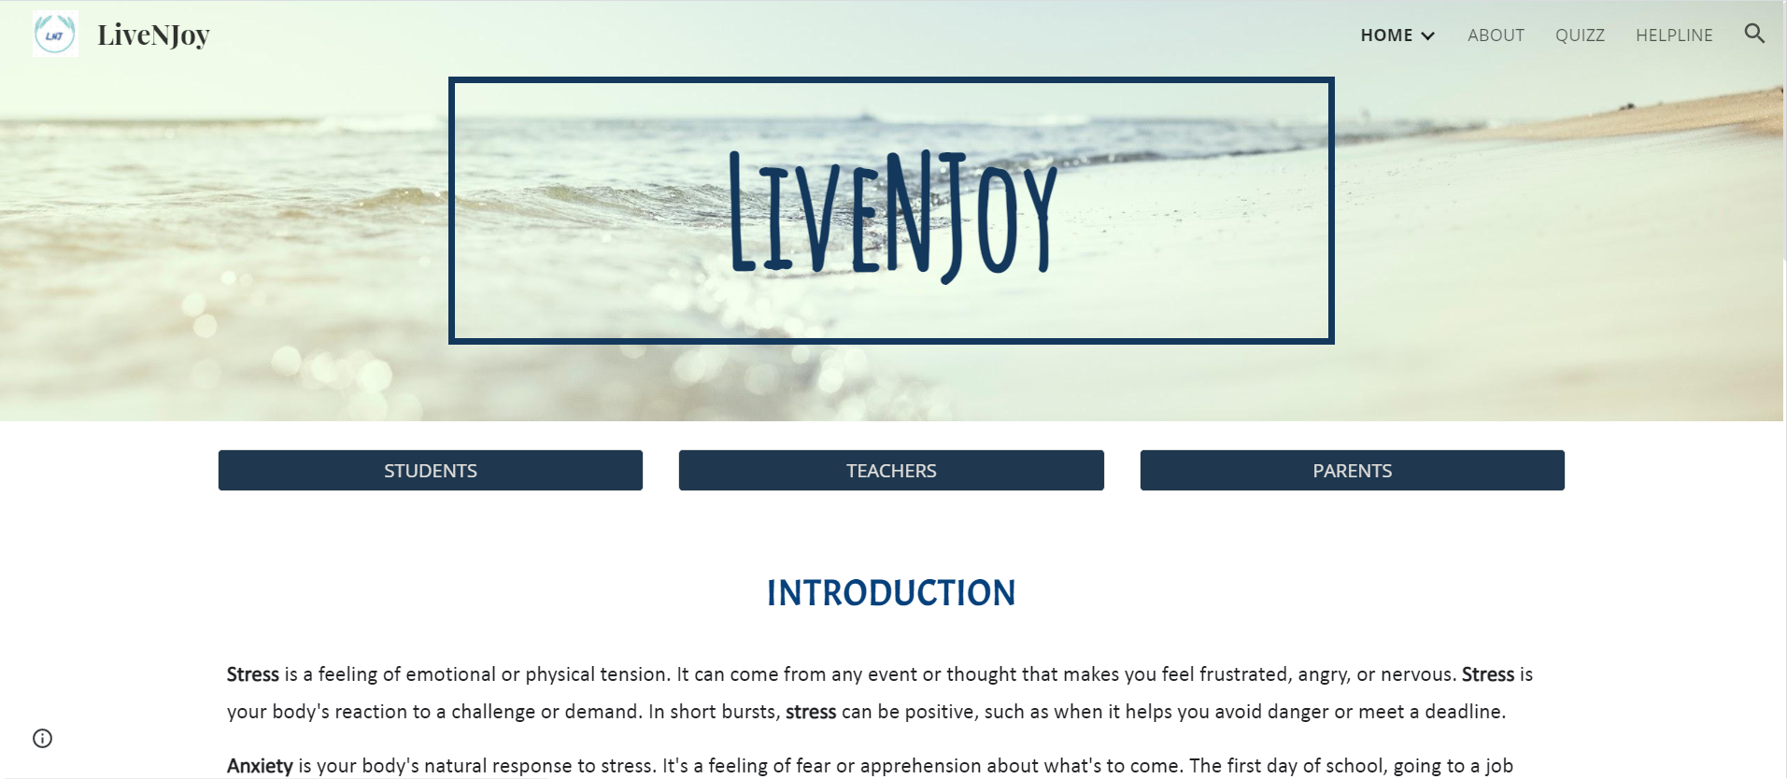
Sabah Sumehra
9 D, Harvest International School
RUNNER-UP
Rs. 200 Gift Voucher
PROTOTYPE NAME:
LiveNJoy
SUMMARY:
A website that helps students, teachers & parents overcome stress, depression, anxiety through various ways and helps one lead a healthy and happy life.

Slide 25

Kshitish Raj Dwivedi
9 A, Air Force School Hebbal
RUNNER-UP
Rs. 200 Gift Voucher
PROTOTYPE NAME:
Strain Free Vision
SUMMARY:
An application that gives reminders to students working on electronic devices for long hours so that they can rest their eyes and perform eye exercises to avoid eye strain and eye damage.

Slide 27
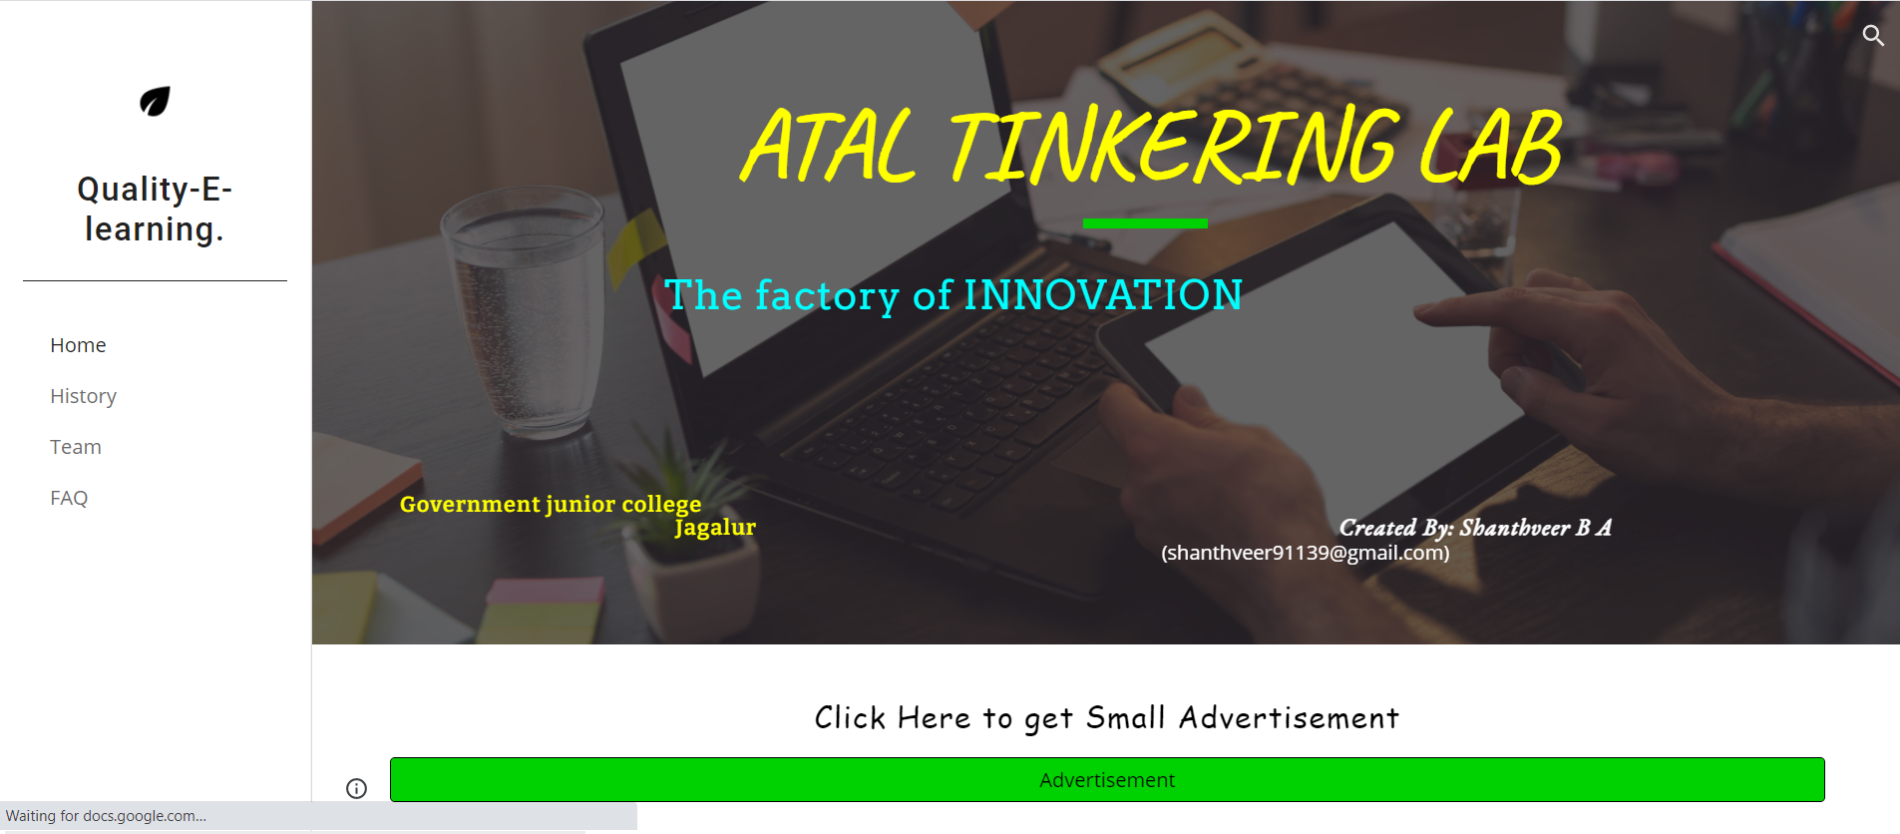
Shanthveer B A
11 A, Puspha Mahalingappa P U college , Davanagere
RUNNER-UP
Rs. 200 Gift Voucher
PROTOTYPE NAME:
QUALITY-E-LEARNING
SUMMARY:
A web portal that offers various digital skills for students to learn on their own in a fun-filled and experiential manner.

Slide 29
WINNERS
STUDENTS

Slide 30
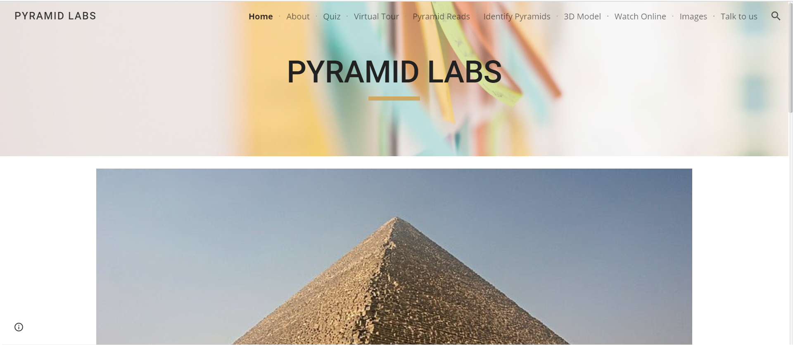
Amaanullah A Mamdapur
6 B, Air Force School Hebbal
WINNER
Rs. 300 Gift Voucher
PROTOTYPE NAME:
Pyramid Labs
SUMMARY:
Pyramid Labs is a platform that makes learning / teaching more engaging, entertaining, involving, and fun for students / teachers.

Slide 32
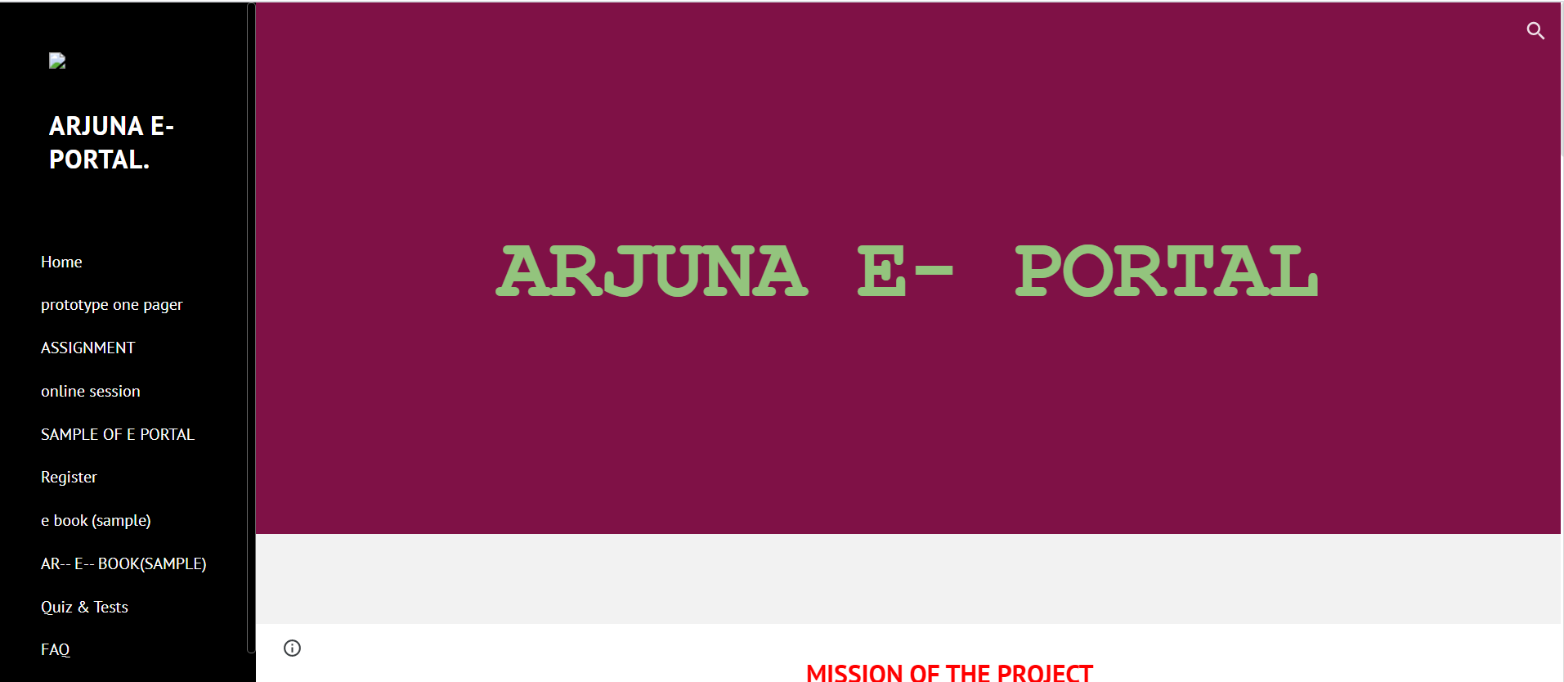
Anchit T Bhatt
10 A, Sri Vidya Kendra The Smart School
WINNER
Rs. 300 Gift Voucher
PROTOTYPE NAME:
ARJUNA E-PORTAL
SUMMARY:
Arjuna E-Portal is solution that brings a robotic teacher and an eBook together within one platform.

Slide 34

Sagarika Shyam
12 A Air Force School Hebbal
WINNER
Rs. 300 Gift Voucher
PROTOTYPE NAME:
SHIKSHA मित्र
SUMMARY:
Shiksha Mitr is an interactive website that enables students make their transition to higher-secondary school a smoother and easier experience by making learning fun and allowing students to gain knowledge while having the time of their life.

Slide 36

Kashyap Subramanian
12 A, Harvest International School
WINNER
Rs. 300 Gift Voucher
PROTOTYPE NAME:
Python Basics
SUMMARY:
This portal allows students to learn basics of Python programming and take tests to check their learning at each level.

Slide 38
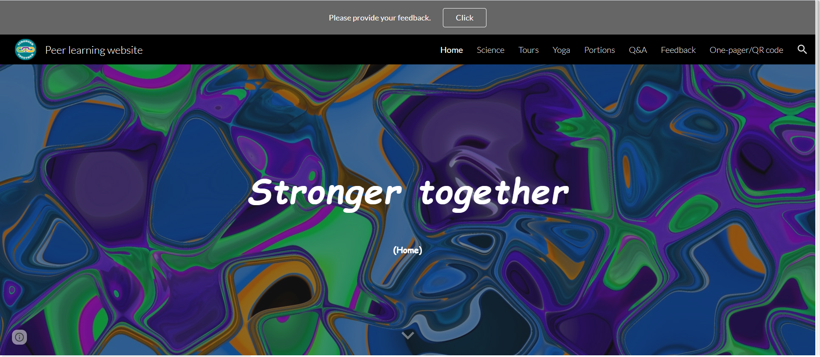
Anirudh G Kashyap
10 C, Sri Vidya Kendra The Smart School Bengaluru
WINNER
Rs. 300 Gift Voucher
PROTOTYPE NAME:
Peer learning website
SUMMARY:
This portal allows teachers and students to share useful resources, students can ask questions to the teachers, (and also assess themselves) so that we have a safe and enthusiastic learning environment.

Slide 40
WINNERS
TEACHERS & PARENTS

Slide 41

Swathi G
Teacher, Shri Vyasa Maharshi Vidya Peetha, Mulky
WINNER – TEACHER
Rs. 200 Gift Voucher
PROTOTYPE NAME:
Fiber Optics
SUMMARY:
Visitors to a museum or industry can do without a guide by simply scanning a QR code on an artifact and get more information about it.

Slide 43
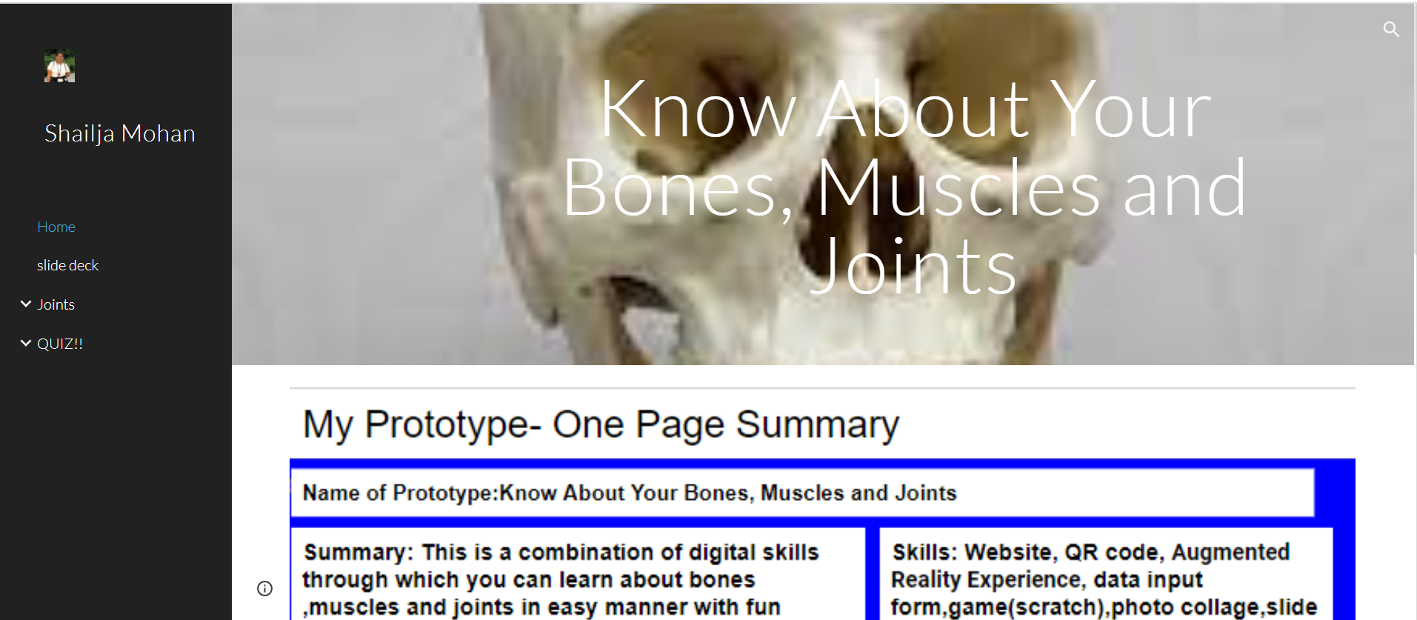
Shailja Mohan
Parent
WINNER - PARENT
Rs. 200 Gift Voucher
PROTOTYPE NAME:
Know About Your Bones, Muscles and Joints
SUMMARY:
People can know and learn about their own body in an easy manner.

Slide 45
STUDENT MENTOR RECOGNITION

Slide 46
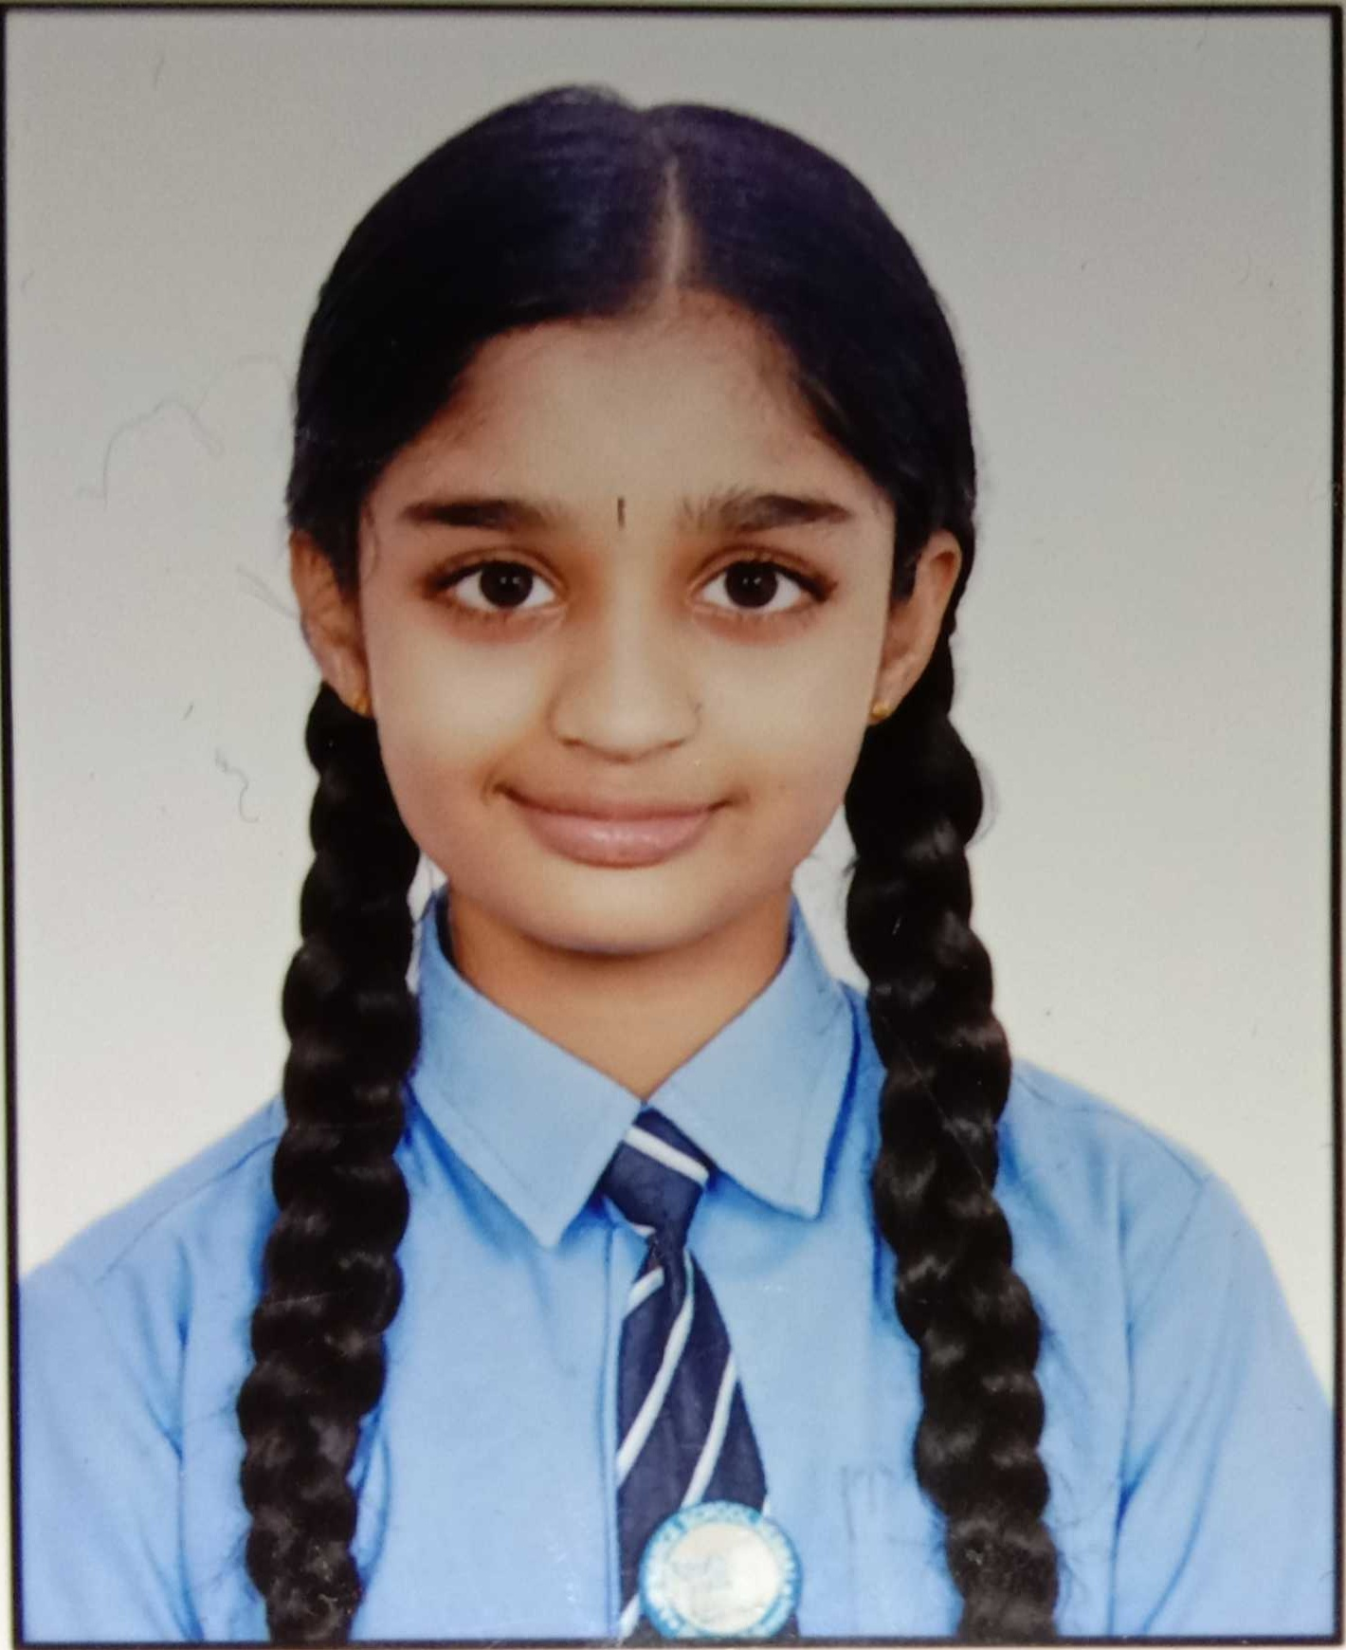
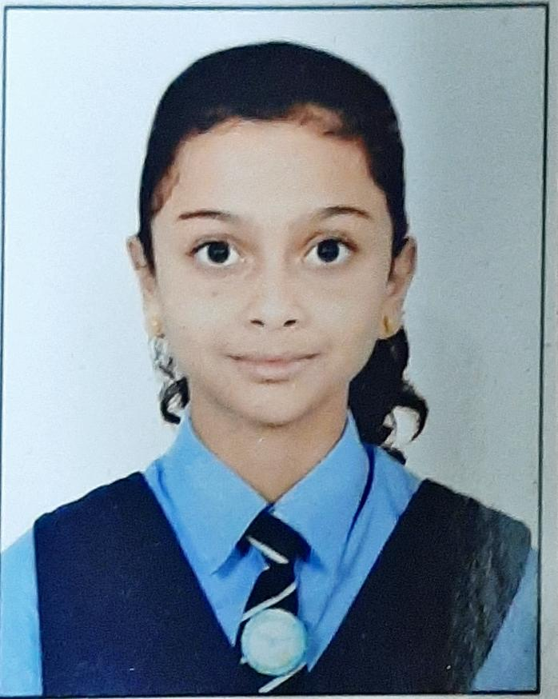
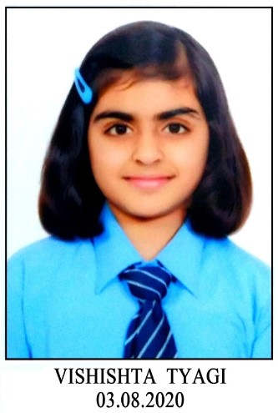
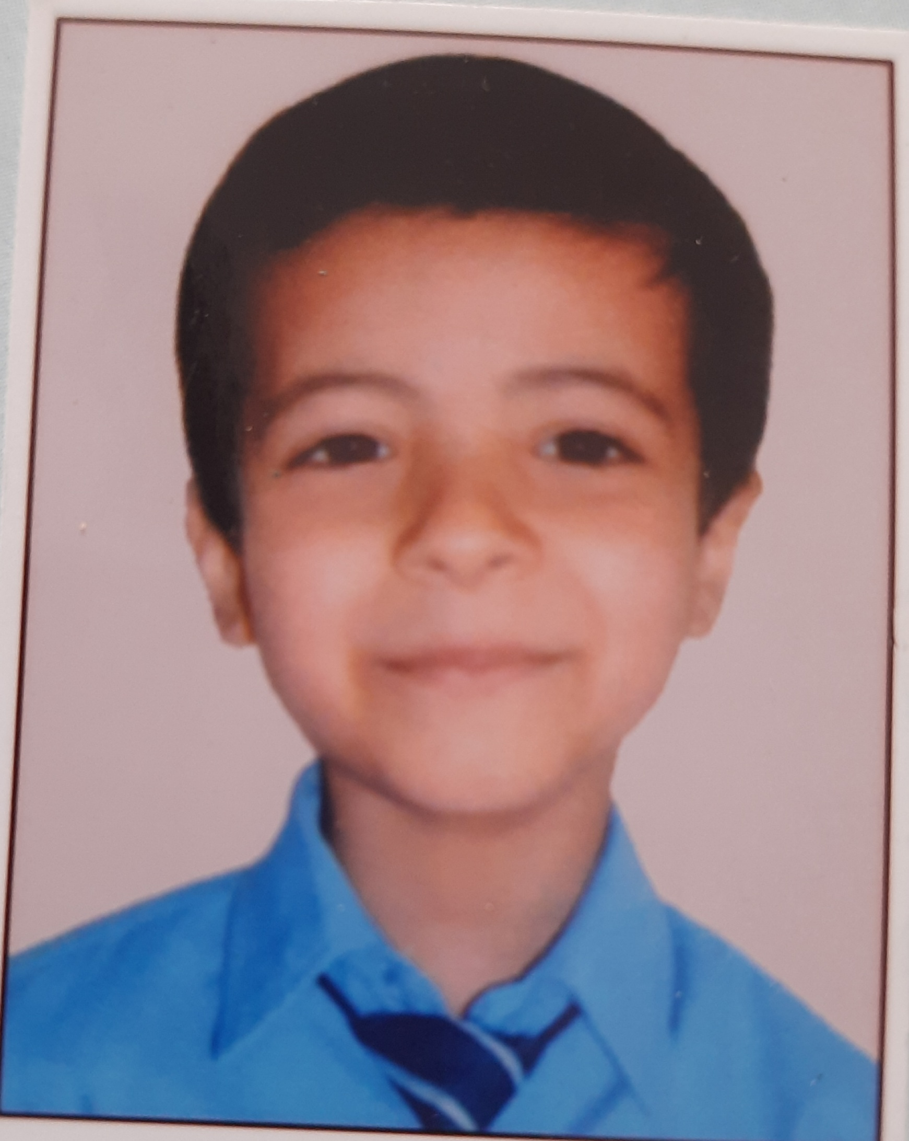
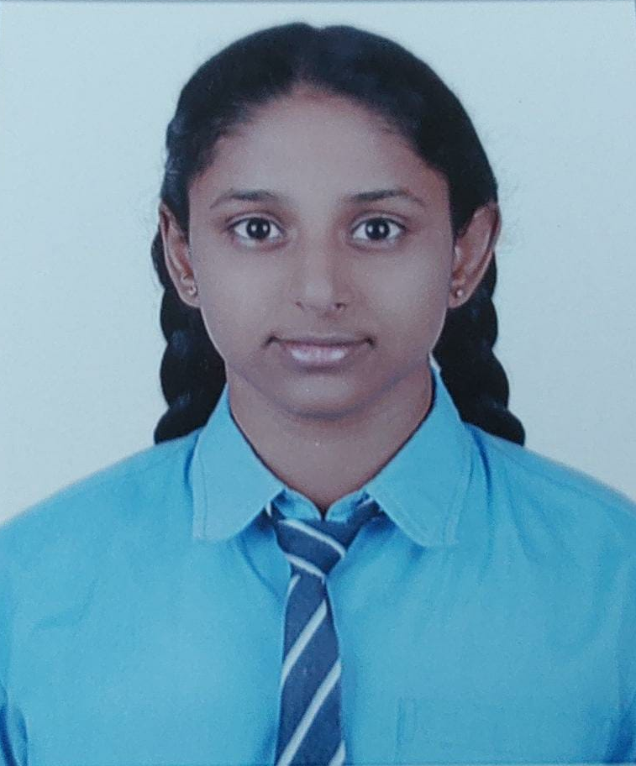
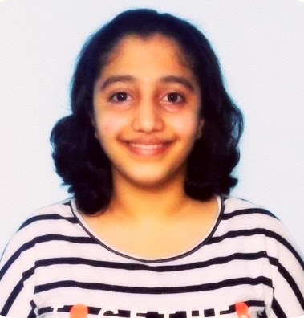
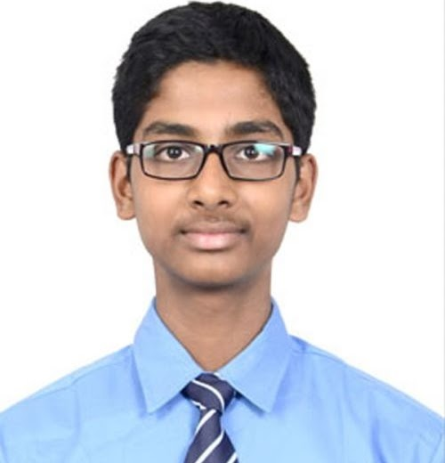
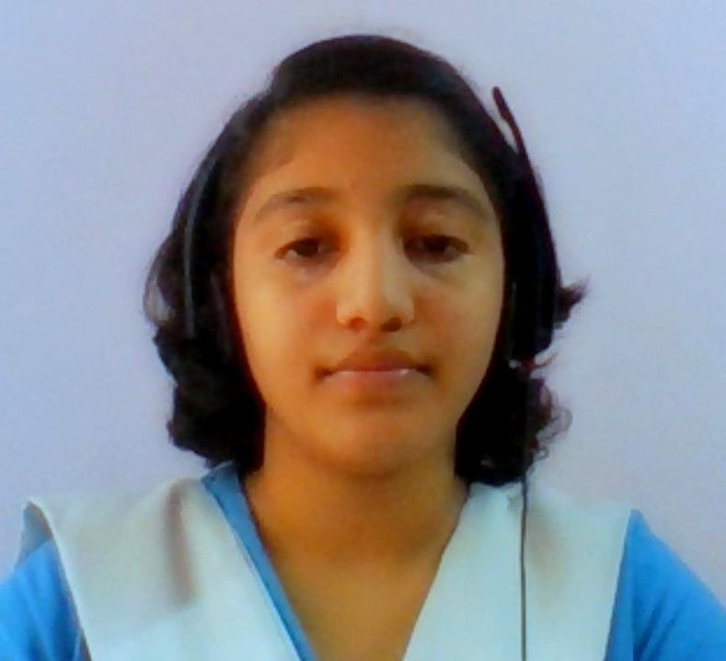
Student Mentor Recognitions
Nakshatra R
Srushti Sandeep
Vishishta Tyagi
Manas Mehandiratta
Parnika M
Tanisha Karve
Vijaysubramanian

Slide 47

Mentor Recognition
Mr. Kiran Kumar, Mentor of Change Air Force School Hebbal,
Regional Mentor of change of Karnataka

Slide 48
ADDRESS BY GUEST OF HONOUR
Ms. Deepali Upadhay,
Program Director, Atal Tinkering Labs,
AIM, NITI Aayog, Govt. of India

Slide 49

Continue the journey of tinkering …

